Slide 1

USWDS Monthly Call
May 2021
1
Notes:
Hi there and welcome to the US Web Design System monthly call… [CLICK] ...May 2021. And, for May, the USWDS logo has a late-spring palette of green, blue, gold, pink, and moss. [beat]

Slide 2

Hi!
Thanks for being here!
2
Notes:
My name is Dan Williams, and I'm the USWDS product lead and this is my avatar, which may or may not look like me. Either way, thanks for being here! First, I'd like to mention that we're recording this monthly call, and — as always — we post these recordings to YouTube, so please refrain from turning on your camera. We will manually turn off any cameras to ensure the recording doesn't show us on camera. I’d also like to remind you that all attendees must abide by the TTS Code of Conduct, which is online at handbook.tts.gsa.gov/code-of-conduct. We’ve posted the link to the code of conduct in the chat. We'll be posting other links and references into the chat as we go along, and I encourage you to ask questions in the chat at any time. If any member of our team can answer your question in the chat, we'll do so, otherwise there'll be some time for questions and answers at the end of the hour. Also, be sure to introduce yourself in the chat as well — it's nice to know who's here. It's good to have you here today. So thanks! And, with that, let's get started!

Slide 3
A quick poll
How well do you understand the Paperwork Reduction Act?
Very well. I know what it says and how it applies to my work.
Somewhat well. And I know where to look if I have questions.
A little bit. It really confuses me every time I think about it!
Not at all! What's the Paperwork Reduction Act?
3
Notes:
So, to kick things off, a quick lil poll: How well do you understand the Paperwork Reduction Act? 1: Very well. I know what it says and how it applies to my work. 2: Somewhat well. And I know where to look if I have questions. 3: A little bit. It really confuses me every time I think about it! 4: Not at all! What's the Paperwork Reduction Act? If you're interested in answering, give it a go. We're just interested to hear more from folks on the call. If you can't see the poll or can't access it for any reason, either put your answer in the chat, or just feel comforted that it's a pretty unserious poll with no stakes. We'll share out the results in just a minute.

Slide 4
Agenda
Site launches Global Accessibility Awareness Day USWDS and Accessibility Q&A
4
Notes:
So what's our agenda for today? [CLICK] First, as always, we'll show off a few nice new site launches. [CLICK] Then we'll kick off our Global Accessibility Awareness Day program by talking with a few folks who are thinking about accessibility every day. [CLICK] And then I'll go into a bit of detail about how we approach accessibility — how we think about accessibility and what we do to deliver accessible components and guidance, as well as what teams need to keep in mind to build accessibly with the design system. [CLICK] And I'll try to keep all this down to about 30 minutes or so. We're trying to deliver more snappy monthly calls. This should give us some more time to get questions and feedback from you — so ask questions in the chat as we go, or hold on to your Qs to the end. I swear we'll have time today!

Slide 5
Site launches
Notes:
Let's get into site launches.

Slide 6
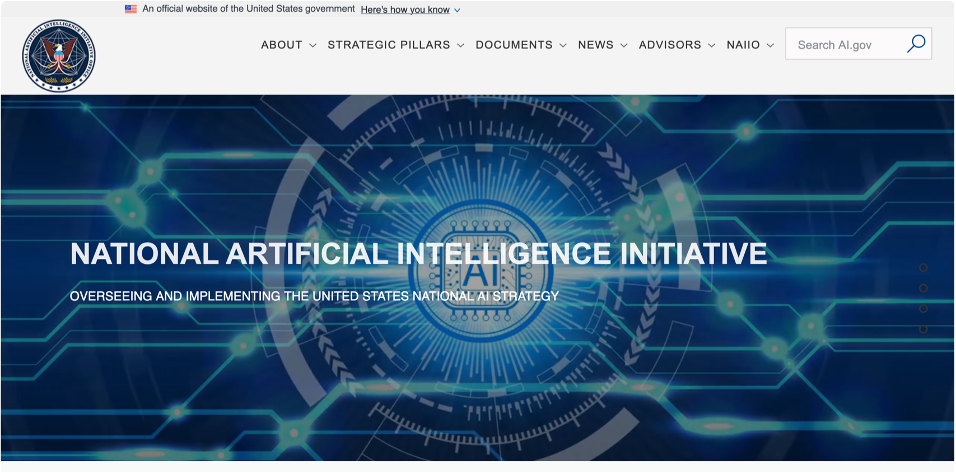
National Artificial Intelligence Initiative
ai.gov
Notes:
First up, ai.gov, the website of the National Artificial Intelligence Initiative. Its homepage shows a gleaming network of nodes with the words National Artificial Intelligence Initiative.

Slide 7
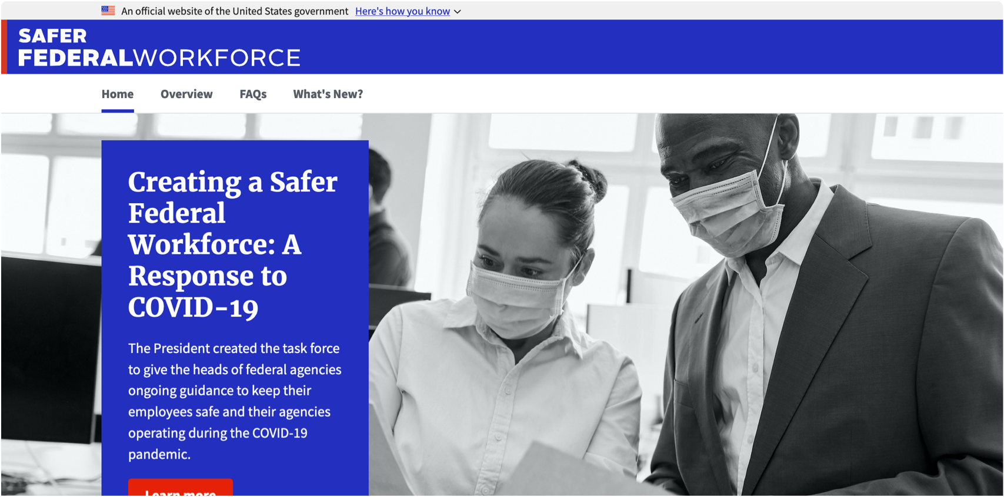
Safer Federal Workforce Task Force
saferfederalworkforce.gov
Notes:
Here's saferfederalworkforce.gov, a crisp documentation site for the Safer Federal Workforce Task Force. This site shows bright blues and reds, a photo of two employees wearing masks, and the words: "Creating a safer federal workforce: A response to COVID-19" .

Slide 8
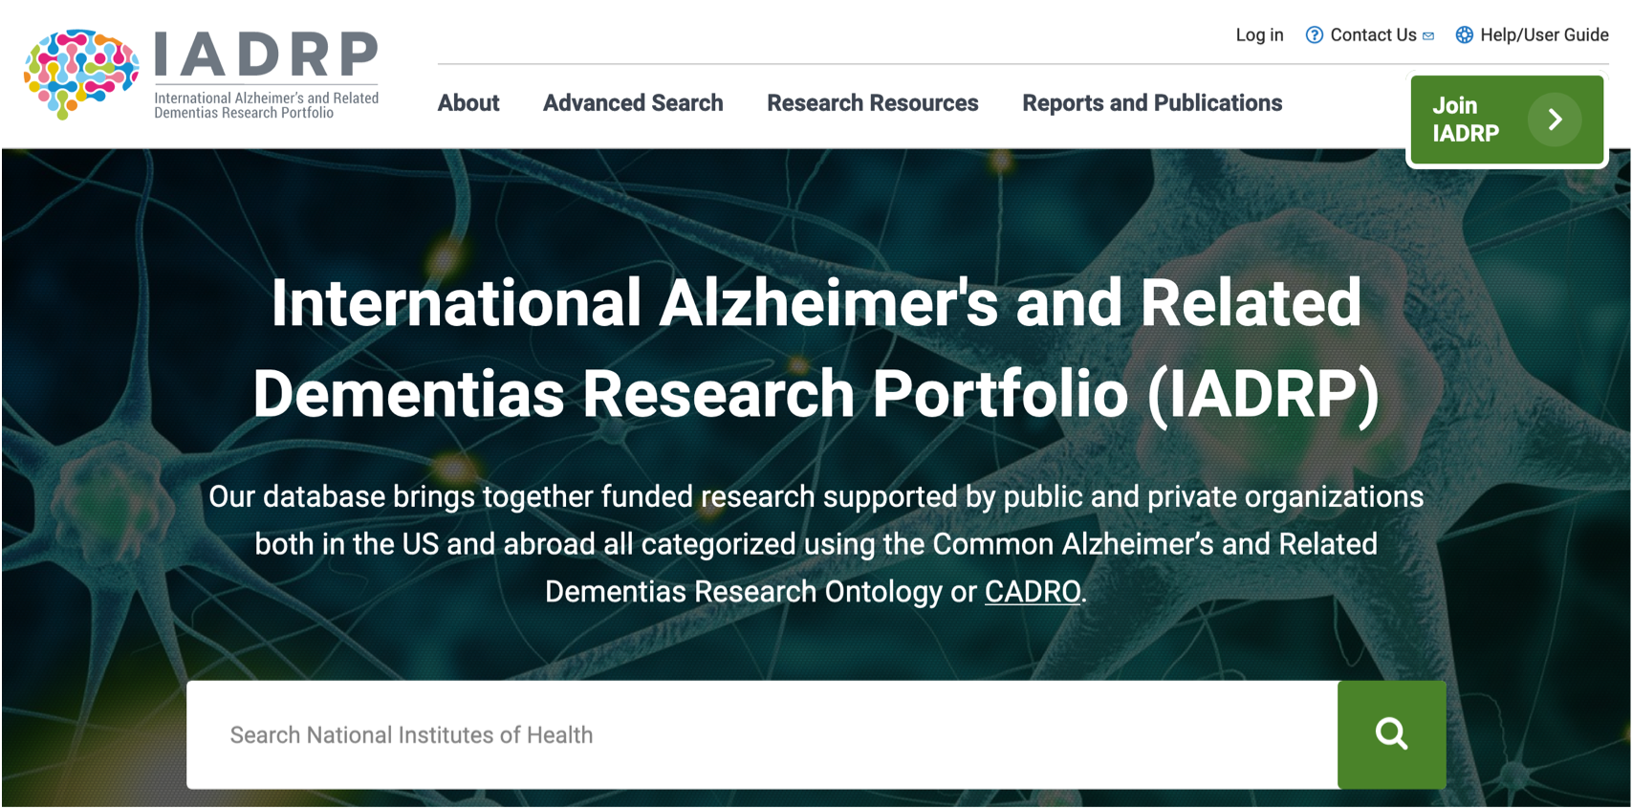
International Alzheimer’s and Related Dementias Research Portfolio
iadrp.nia.nih.gov
Notes:
Next, iadrp.nia.nih.gov, the home of the International Alzheimer’s and Related Dementias Research Portfolio. The homepage shows a green button, a large search bar, and a full-page image of neurons.

Slide 9
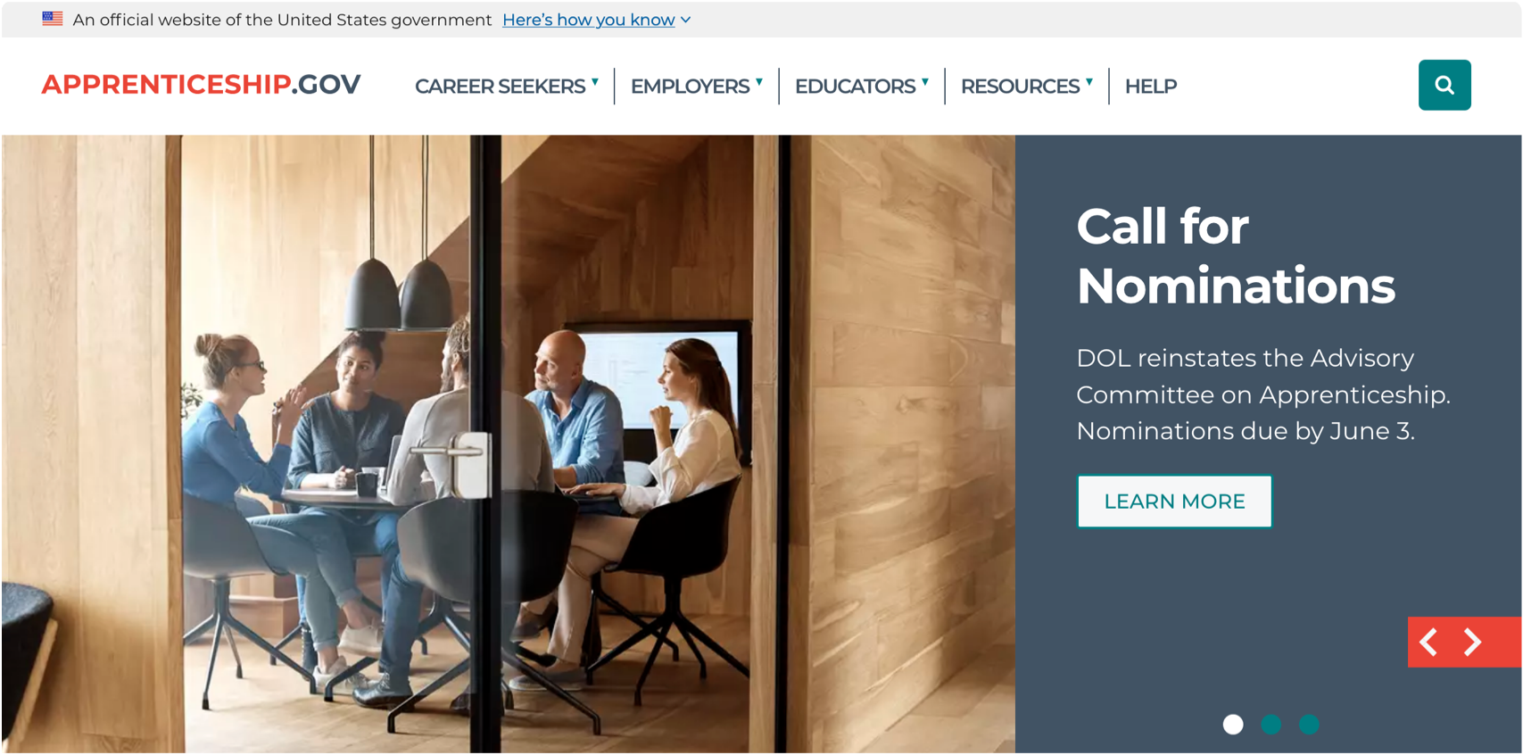
apprenticeship.gov
Notes:
Now, apprenticeship.gov, a site to connect apprentices and apprentice programs. This site shows a clean image for a modern conference room, and a gray text area that reads: "Call for nominations".

Slide 10
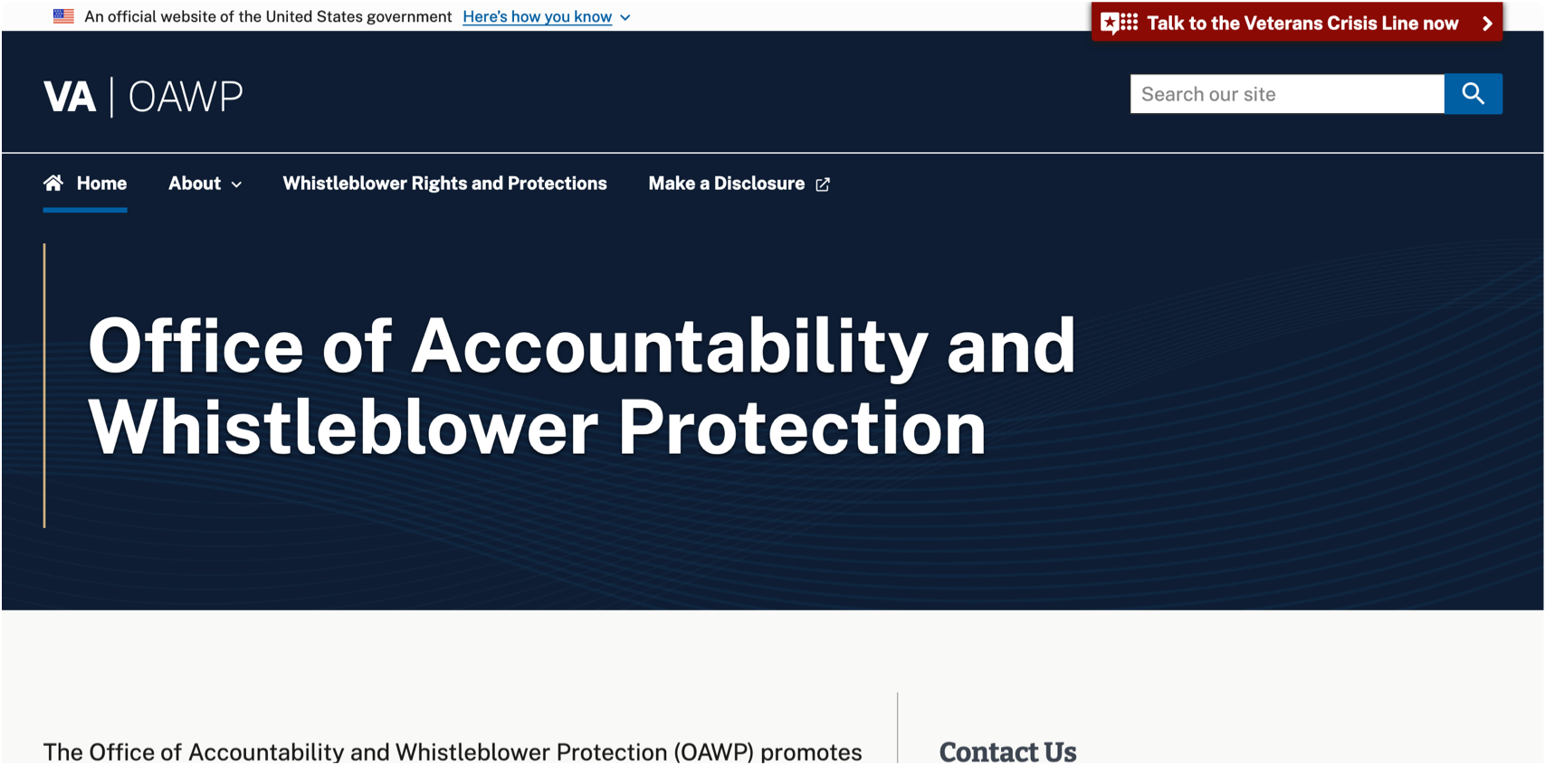
VA Office of Accountability and Whistleblower Protection
va.gov/accountability
Notes:
And finally, va.gov/accountability, the VA Office of Accountability and Whistleblower Protection. This page shows a minimal and professional field of blue below a VA header. The page reads "Office of Accountability and Whistleblower Protection".

Slide 11
Great work!
Notes:
Great work, everyone! Be sure to let us know when a new site launches, either with an email to uswds@support.digitalgov.gov or a note on the USWDS public Slack channel.

Slide 12
Global Accessibility Awareness Day
Notes:
So today is Global Accessibility Awareness Day, and to help us understand a bit more about what accessibility means and how to think about it in our own work, I've asked a few folks who work in accessibility every day to come and share their perspective. Over the last week, our team was able to sit down with them and we put together this short video. I'll show it to you now.

Slide 13
Video
Notes:
[INTRO: Thanks for agreeing to speak with our community on global accessibility awareness day. I'd like to start by asking each of you to introduce yourself…]
[VIDEO]
[OUTRO: And I'd just like to add, for any folks interested in improving the accessibility of their products: thank you. It makes a difference. And thank you to John, Lisa, Randall, and Robert for making the time to talk with us.]

Slide 14
USWDS and Accessibility
Notes:
Next: USWDS and accessibility, and how we help you create more inclusive federal websites.

Slide 15
How do we think about accessibility from the start?
Notes:
Those are all important reasons to use USWDS — and they may have contributed to why your team uses the design system. But today we’re going to look at a few of the core values USWDS delivers to government teams.

Slide 16
Usability for all abilities.
Notes:
To say "accessibility" is to refer to a deep and complex subject that might be summarized as "usability for all abilities" and, more specifically and pointedly, as "usability for those not served by majority solutions". It requires that our services do not discriminate by ability nor by the specifics of necessary assistive technology. Building with accessibility in mind requires that we build not just for our own current abilities, nor exclusively for any simple majority (imagined or otherwise), but explicitly and intentionally for those who would be excluded by narrow majoritarian solutions.

Slide 17
Accessibility isn’t just for someone else.
Notes:
This — perhaps obviously — is critically important to people with permanent disabilities, but all of us will face temporary or situational disabilities throughout our lives. We will all get older, with aging's effects on hearing, vision, motor skills, and cognition. We may get injured. Or we may just have to use our phones in bright sunlight, with one hand, while tired, and with a child constantly asking us questions. Usability isn’t just for someone else. In other words, we may not use a wheelchair, but we may occasionally push a stroller. The reality of contextual ability is just part of the reason that accessibility concerns should be all of our concern — the electronic “curb cut” effect.
Finally, especially with government services, we're designing for when things are important, required, stressful, emotional, meaningful, complicated, and tough. We're not typically designing for best-case scenarios.

Slide 18
Section 508 and WCAG
Notes:
Section 508 and WCAG. Today, when we think practically about accessibility in digital services, we think about the requirements of Section 508 of the Rehabilitation Act of 1973, amended in 1998 to require Federal agencies to make their electronic and information technology accessible to people with disabilities. And we think about the requirements of WCAG, or the Web Content Accessibility Guidelines, an evolving set of requirements, now in version 2.1. These requirements are related. Section 508 incorporates by reference the WCAG 2.0 Level AA success criteria.

Slide 19
Perceivable Operable Understandable Robust
Notes:
The goal of both these requirements is to provide services that are Perceivable, Operable, Understandable, and Robust: Perceivable: Users must be able to perceive the information presented. Operable: Users must be able to operate the interface. Understandable: Users must be able to understand both how the user interface operates and the meaning of information presented. Robust: Users must be able to access the content as technologies advance. As technologies like browsers and other assistive technology evolve, the content should remain accessible.

Slide 20
What needs do these requirements address?
Notes:
What needs do requirements like Section 508 and WCAG address? To speak very broadly about current requirements like Section 508 and WCAG, it's that they require considering the needs of a few specific user types — needs that the design system builds into our design language, components, guidance, and layouts:

Slide 21

Blind users
Support screen readers and assistive technology
Outline semantic landmarks and regions
Assure all content has clear context and labeling
Provide text equivalents for visual resources
Announce updates of page state changes
Avoid visual-exclusive meaningful functionality
Notes:
Blind users:
Support screen readers and assistive technology
Outline semantic landmarks and regions
Assure all content has clear context and labeling
Provide text equivalents for visual resources
Announce updates of page state changes
Avoid visual-exclusive meaningful functionality

Slide 22
Limited-vision users
Design for readability
Design generous, forgiving interaction targets
Allow layouts to respond to user scaling settings and screen magnifiers
Prefer linear layouts
Don’t rely on hover for critical information
Use legible visual contrast
Avoid color-exclusive meaningful functionality
Notes:
Limited-vision users:
Includes colorblindness, limited range of vision
Design for readability
Design generous, forgiving interaction targets
Allow layouts to respond to user scaling settings and screen magnifiers
Prefer linear layouts
Don't rely on hover for critical information
Use legible visual contrast
Avoid color-exclusive meaningful functionality

Slide 23
Deaf users
Provide text equivalent for audio resources
Avoid audio-exclusive meaningful functionality
Notes:
Provide text equivalent for audio resources
Avoid audio-exclusive meaningful functionality

Slide 24
Limited-mobility users
Support keyboard-only (linear) functionality
Support touchscreen (direct input) functionality
Design generous readability and interaction targets
Prefer linear layouts
Don’t rely on hover for critical information
Notes:
Limited-mobility users:
Support keyboard-only (linear) functionality
Support touchscreen (direct input) functionality
Design generous readability and interaction targets
Prefer linear layouts
Don't rely on hover for critical information

Slide 25
Sensory-sensitive users
Keep it simple
Avoid flashing and repetitive animation
Avoid very high contrast
Avoid alarming colors and images
Avoid audio and video that start automatically
Notes:
Sensory-sensitive users:
Keep it simple
Avoid flashing and repetitive animation
Avoid very high contrast
Avoid alarming colors and images
Avoid audio and video that start automatically

Slide 26
This is not a comprehensive list.
Accessibility is a dynamic and open-ended design process
Notes:
Note that this is not a comprehensive list, and that real-life users may fall into multiple categories. For instance, limited-vision users may use screen readers in addition to screen magnifiers. And we also know that cognitive differences and neurodiversity are becoming more and more of an accessibility focus as well. Accessibility requirements may be somewhat static, but accessibility itself is as dynamic and open-ended as any design process.

Slide 27
What does USWDS do to support accessible products?
Deliver individual components built to conform to WCAG 2.1
Provide guidance on how to implement those components accessibly
Include accessibility-focused tools to build new functionality
Feature smart settings that allow accessible customization with minimal custom code
Make accessibility one of our core design principles
Notes:
So what does the design system do to support accessible products?
Deliver individual components built to conform to WCAG 2.1
Provide guidance on how to implement those components accessibly
Include accessibility-focused tools to build new functionality
Feature smart settings that allow accessible customization with minimal custom code
Make accessibility one of our core design principles

Slide 28
Deliver individual components built to conform to WCAG 2.1 (1 of 2)
If it isn’t accessible, it won't ship
Test with screen readers (VoiceOver, NVDA)
Test with keyboard-only
Test with touch-only
Test across browsers and operating systems
Notes:
Deliver individual components built to conform to WCAG 2.1: If it isn't accessible, it won't ship Test with screen readers (VoiceOver, NVDA) Test with keyboard-only Test with touch-only Test across browsers and operating systems

Slide 29
Deliver individual components built to conform to WCAG 2.1 (2 of 2)
Collect community feedback
Scan with automated tools — like pa11y and aXe — on every code change
Manually test functionality with a Trusted Tester
Notes:
Collect community feedback
Scan with automated tools — like pa11y and aXe — on every code change
Manually test functionality with a Trusted Tester

Slide 30
Provide guidance on how to implement our components accessibly
Include an accessibility section with each component
Notes:
Provide guidance on how to implement those components accessibly:
Include an accessibility section with each component

Slide 31
Include accessibility-focused tools to build new functionality
Colors with magic number contrast
Rem-based size tokens and an em-based media query mixin that respond to user scale settings
Normalized typography tokens that provide reliable, readable results regardless of the typeface
Notes:
Include accessibility-focused tools to build new functionality:
Colors with magic number contrast
Rem-based size tokens and an em-based media query mixin that respond to user scale settings
Normalized typography tokens that provide reliable, readable results regardless of the typeface

Slide 32
Feature smart settings that allow accessible customization with minimal custom code
Adding more smart components that change their color based on background
Smart settings for links that choose accessible link and hover states
Notes:
Feature smart settings that allow accessible customization with minimal custom code:
Adding more smart components that change their color based on background
Smart settings for links that choose accessible link and hover states

Slide 33
Make accessibility one of our core design principles
It’s not only part of our mission to embrace accessibility in our own work, but to do what we can to encourage it
We prioritize accessibility issues.
Notes:
Make accessibility one of our core design principles:
It's not only part of our mission to embrace accessibility in our own work, but to do what we can to encourage it
We prioritize accessibility issues. We will work hard to fix accessibility-related issues quickly, and to get them into the next available release. Accessibility is a mission-critical service for USWDS, and we want to know when there's an opportunity to fix something that's broken or improve something that could be better.

Slide 34
What we do only gets your product part of the way there
Notes:
But our accessibility work — what we do — only gets your product part of the way there. Designing with USWDS is a great way to incorporate accessibility early, but what you build with USWDS and how you compose that work is just as important. Just as you could build a completely impractical kitchen from perfectly acceptable constituent parts, the most important part of your own accessibility is in its holistic experience. In fact, the most recent drafts of WCAG 3.0 — the probable successor to WCAG 2.1 — makes a distinction between atomic tests (the mostly automated tests that test each section of your site against specific criteria, similar to WCAG 2.1) and holistic tests (which are closer to standard usability testing and human-centered design). Regardless of the methodology in WCAG, it's important to recognize that building with accessible components does not guarantee an accessible service. We recommend a mix of automated, semi-automated, and manual testing in addition to actual tests with real people who need assistive accommodations to interact with services effectively.

Slide 35
Today We’re publishing updated accessibility resources
designsystem.digital.gov/documentation/accessibility
Notes:
Today, we're publishing a new page on our website that collects accessibility resources and outlines what both the design system and its users need to do to better embrace accessibility from start-to-finish in every development cycle.
And we plan to add more resources such as collecting past, current, and upcoming accessibility improvements on this page as well, so you can see what we're working on, and what we've addressed as the design system evolves.

Slide 36
Focus on the really key stuff
User testing
Great content
Clear organization
Straightforward services
Notes:
All of this is in the service of what we hope the design system can do for any project: Make the technical requirements part of the solution from the start, so you can really focus on the really key stuff: User testing, great content, and clear organization — simple, straightforward services.

Slide 37
Thank you.
Notes:
Thanks for joining us on Global Accessibility Awareness Day. Let's do what we can to let technology enable participation, not frustrate it.

Slide 38
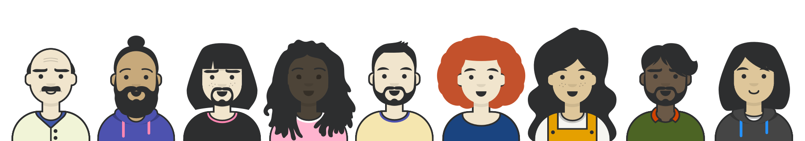
Q&A
Notes:
So let's get into questions and answers. We're going to be experimenting with something new this week. We're going to turn off recording for Q&A, both to keep the recordings shorter, and to see if it allows us to ask and answer different kinds of questions. So don't be shy. We'll turn off the recording and open the floor now!

Slide 39



Next month
Pagination
#uswds-public
github.com/uswds
designsystem.digital.gov
Notes:
Thanks for joining today's USWDS monthly call. Next month, the monthly call is on June 17, the third Thursday of June, and we'll be discussing Pagination.
And, as always, I encourage you to join our community in the #uswds-public Slack channel so you can follow our progress, get answers, and contribute to the discussion.
Follow us on Github at github.com/uswds, check out our website, and visit designsystem.digital.gov/about/community to join us and your colleagues across government who are using USWDS.
Thank you, and see you next month!

